Slide 1
Relational Database
Management System
116U01C403
Module 2 .4 Mapping EER to Relational Model
Jan 2024-May 2024

Slide 2
ER-to-Relational Mapping
ER-to-Relational Mapping Algorithm
  Step 1: Mapping of Regular Entity Types
  Step 2: Mapping of Weak Entity Types
  Step 3: Mapping of Binary 1:1 Relation Types
  Step 4: Mapping of Binary 1:N Relationship Types.
  Step 5: Mapping of Binary M:N Relationship Types.
  Step 6: Mapping of Multivalued attributes.
  Step 7: Mapping of N-ary Relationship Types.
Mapping EER Model Constructs to Relations
  Step 8: Options for Mapping Specialization or Generalization.
  Step 9: Mapping of Union Types (Categories).

Slide 3
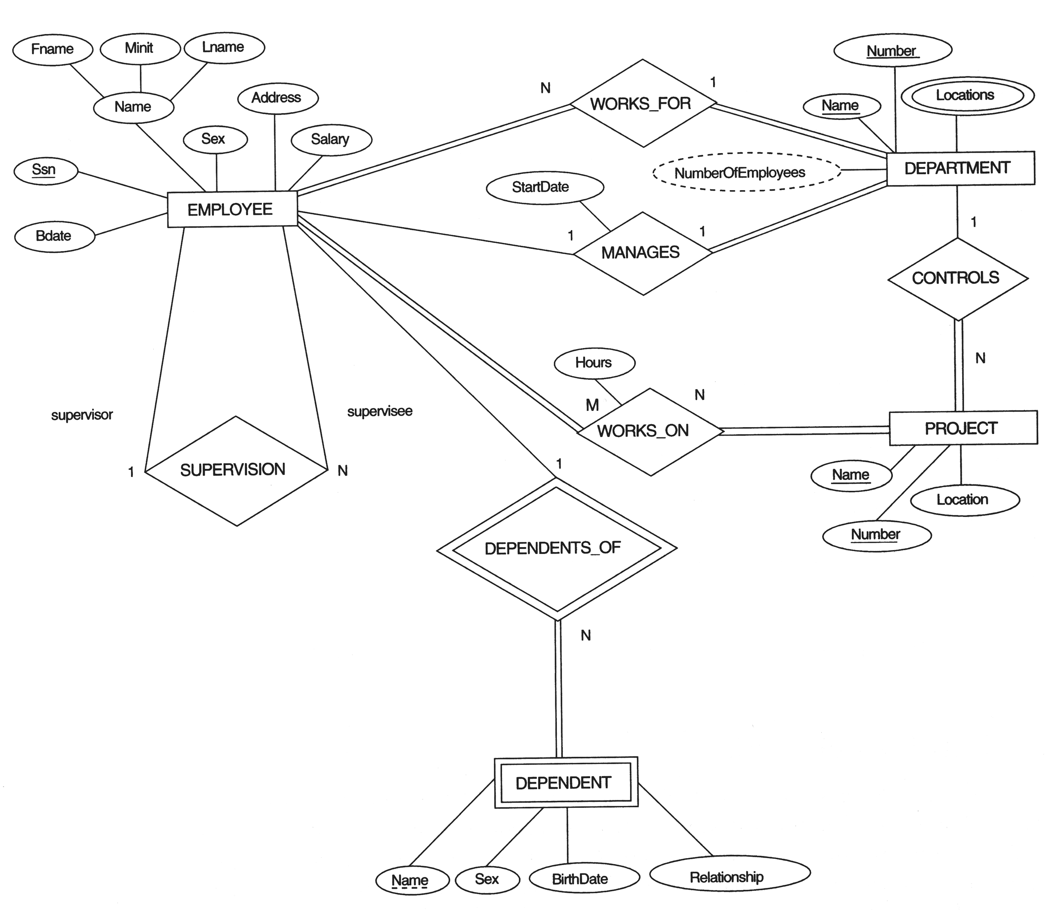

Slide 4
ER-to-Relational Mapping Algorithm
Step 1: Mapping of Regular Entity Types.
  For each regular (strong) entity type E in the ER schema, create a relation R that includes all the simple attributes of E.
  Choose one of the key attributes of E as the primary key for R.
  If the chosen key of E is composite, the set of simple attributes that form it will together form the primary key of R.
Slide 7- 4
Notes:
4

Slide 5
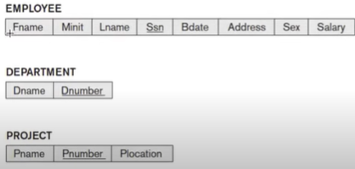
Example:
We create the relations EMPLOYEE, DEPARTMENT, and PROJECT in the relational schema corresponding to the regular entities in the ER diagram.
  SSN, DNUMBER, and PNUMBER are the primary keys for the relations EMPLOYEE, DEPARTMENT, and PROJECT as shown.

Slide 6
ER-to-Relational Mapping Algorithm (contd.)
Step 2: Mapping of Weak Entity Types
  For each weak entity type W in the ER schema with owner entity type E, create a relation R & include all simple attributes (or simple components of composite attributes) of W as attributes of R.
  Also, include as foreign key attributes of R the primary key attribute(s) of the relation(s) that correspond to the owner entity type(s).
  The primary key of R is the combination of the primary key(s) of the owner(s) and the partial key of the weak entity type W, if any.
Slide 7- 6
Notes:
6

Slide 7

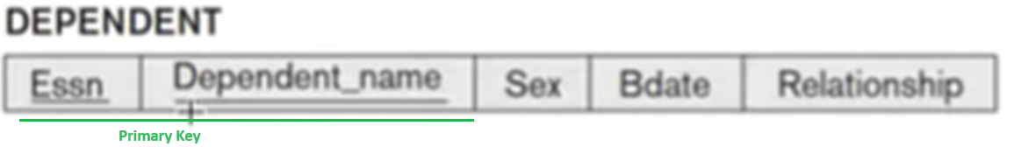
Example: Create the relation DEPENDENT in this step to correspond to the weak entity type DEPENDENT.
  Include the primary key SSN of the EMPLOYEE relation as a foreign key attribute of DEPENDENT (renamed to ESSN).
  The primary key of the DEPENDENT relation is the combination {ESSN, DEPENDENT_NAME} because DEPENDENT_NAME is the partial key of DEPENDENT.

Slide 8
ER-to-Relational Mapping Algorithm (contd.)
Step 3: Mapping of Binary 1:1 Relation Types
  For each binary 1:1 relationship type R in the ER schema, identify the relations S and T that correspond to the entity types participating in R.
There are three possible approaches:
  Foreign Key approach: Choose one of the relations-say S-and include a foreign key in S the primary key of T. It is better to choose an entity type with total participation in R in the role of S.
    Example: 1:1 relation MANAGES is mapped by choosing the participating entity type DEPARTMENT to serve in the role of S, because its participation in the MANAGES relationship type is total.
  Merged relation option: An alternate mapping of a 1:1 relationship type is possible by merging the two entity types and the relationship into a single relation. This may be appropriate when both participations are total.
  Cross-reference or relationship relation option: The third alternative is to set up a third relation R for the purpose of cross-referencing the primary keys of the two relations S and T representing the entity types.
Slide 7- 8
Notes:
8

Slide 9




Slide 10
ER-to-Relational Mapping Algorithm (contd.)
Step 4: Mapping of Binary 1:N Relationship Types.
  For each regular binary 1:N relationship type R, identify the relation S that represent the participating entity type at the N-side of the relationship type.
  Include as foreign key in S the primary key of the relation T that represents the other entity type participating in R.
  Include any simple attributes of the 1:N relation type as attributes of S.
Example: 1:N relationship types WORKS_FOR, CONTROLS, and SUPERVISION in the figure.
  For WORKS_FOR we include the primary key DNUMBER of the DEPARTMENT relation as foreign key in the EMPLOYEE relation and call it DNO.
Slide 7- 10
Notes:
10

Slide 11



We have three 1:N relations, Works_for ,controls and supervision.
Find an entity of N participation ,modify it with primary key of another entity.(such as modify Employee, Project,)

Slide 12
ER-to-Relational Mapping Algorithm (contd.)
Step 5: Mapping of Binary M:N Relationship Types.
  For each regular binary M:N relationship type R, create a new relation S to represent R.
  Include as foreign key attributes in S the primary keys of the relations that represent the participating entity types; their combination will form the primary key of S.
  Also include any simple attributes of the M:N relationship type (or simple components of composite attributes) as attributes of S.
Example: The M:N relationship type WORKS_ON from the ER diagram is mapped by creating a relation WORKS_ON in the relational database schema.
  The primary keys of the PROJECT and EMPLOYEE relations are included as foreign keys in WORKS_ON and renamed PNO and ESSN, respectively.
  Attribute HOURS in WORKS_ON represents the HOURS attribute of the relation type. The primary key of the WORKS_ON relation is the combination of the foreign key attributes {ESSN, PNO}.
Slide 7- 12
Notes:
12

Slide 13
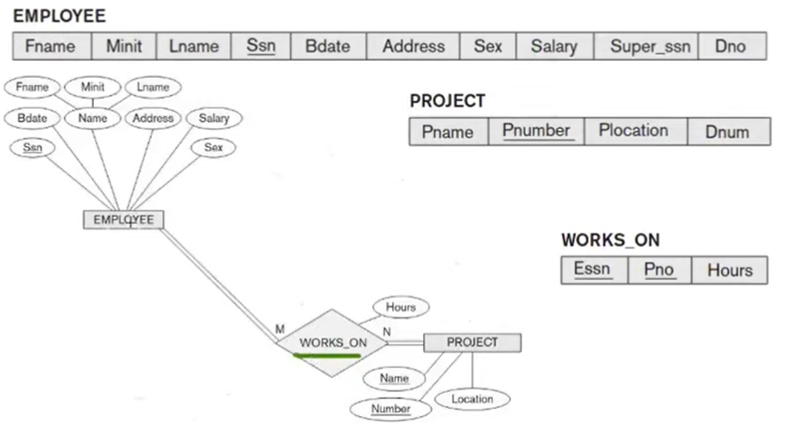

Slide 14
ER-to-Relational Mapping Algorithm (contd.)
Step 6: Mapping of Multivalued attributes.
  For each multivalued attribute A, create a new relation R.
  This relation R will include an attribute corresponding to A, plus the primary key attribute K-as a foreign key in R-of the relation that represents the entity type of relationship type that has A as an attribute.
  The primary key of R is the combination of A and K. If the multivalued attribute is composite, we include its simple components.
Example: The relation DEPT_LOCATIONS is created.
  The attribute DLOCATION represents the multivalued attribute LOCATIONS of DEPARTMENT, while DNUMBER-as foreign key-represents the primary key of the DEPARTMENT relation.
  The primary key of R is the combination of {DNUMBER, DLOCATION}.
Slide 7- 14
Notes:
14

Slide 15
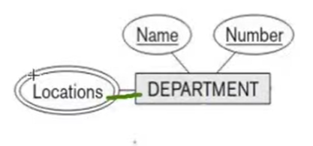


Slide 16
ER-to-Relational Mapping Algorithm (contd.)
Step 7: Mapping of N-ary Relationship Types.
  For each n-ary relationship type R, where n>2, create a new relationship S to represent R.
  Include as foreign key attributes in S the primary keys of the relations that represent the participating entity types.
  Also include any simple attributes of the n-ary relationship type (or simple components of composite attributes) as attributes of S.
Example: The relationship type SUPPY in the ER on the next slide.
  This can be mapped to the relation SUPPLY shown in the relational schema, whose primary key is the combination of the three foreign keys {SNAME, PARTNO, PROJNAME}
Slide 7- 16
Notes:
16

Slide 17
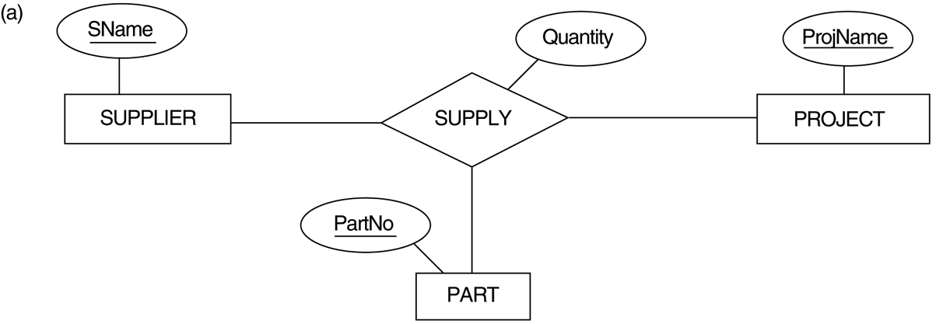
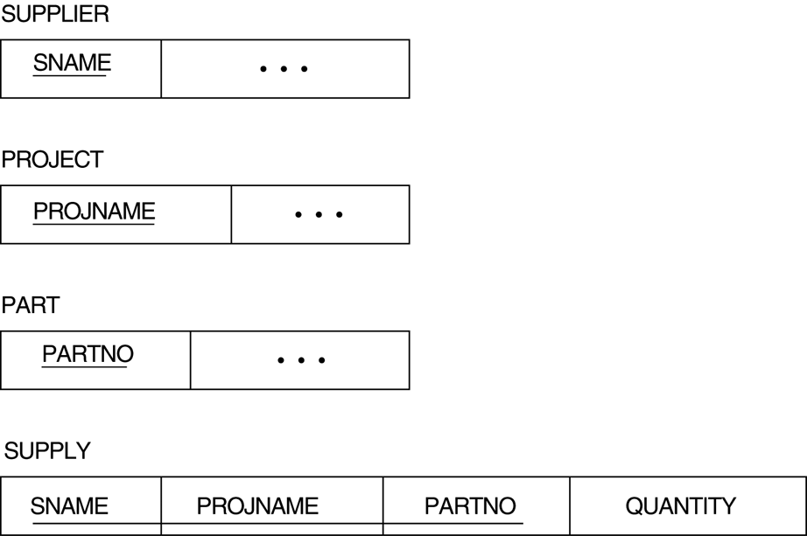
Ternary relationship types. (a) The SUPPLY relationship.
Slide 7- 17
Notes:
17

Slide 18
Mapping the n-ary relationship type SUPPLY from Figure 4.11a.
Slide 7- 18
Notes:
18

Slide 19
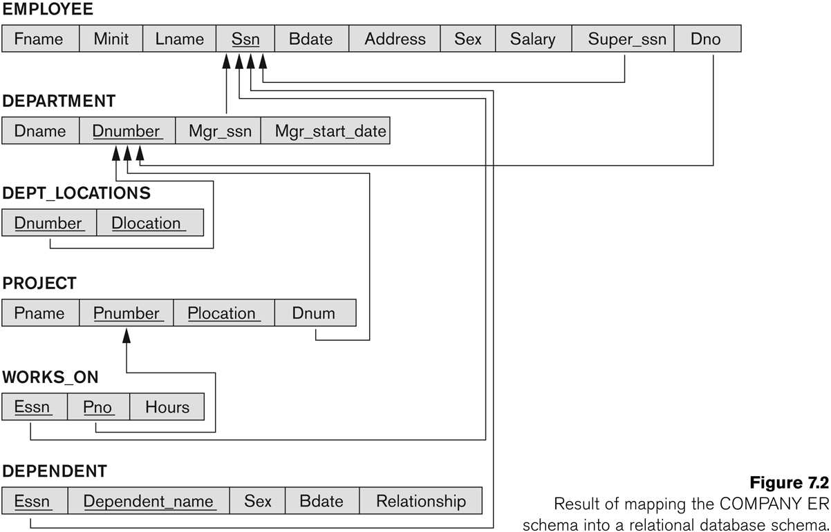
Result of mapping the COMPANY ER schema into a relational schema
Slide 7- 19
Notes:
19

Slide 20
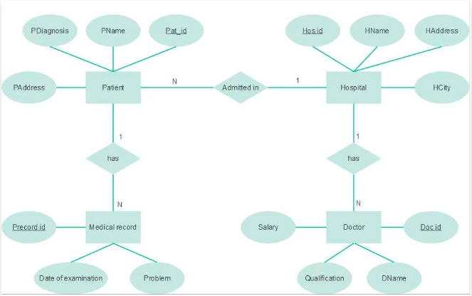
Example

